Slide 1
Single Cell RNAseq Exploration Using Public Available Dataset
Yeting Zhang, PhD

Slide 2
Utilizing public available
scRNA dataset
PBMC from 10X Genomics (3000, 5000 cells, healthy donors).
Phenotype molding of stromal cells in the lung tumor microenvironment (over 50,000 cells).
Human Cell Atlas Project (raw data is available).
Single-Cell RNA-Seq Reveals AML Hierarchies Relevant to Disease Progression and Immunity (bone marrow healthy donor > 7000 cells).
* 10X Genomics PBMC data

Slide 3
A pilot study using public dataset:
scRNA in understanding blood
cancer genomics – Multiple Myeloma
CD138+ cells (in total, 597 cells)
Four cell clusters based on the publication
Research Strategy
Raw data from GEO database (GSE118900)
Seurat pipeline (https://satijalab.org/seurat/)
Cell cluster Identification

Slide 4
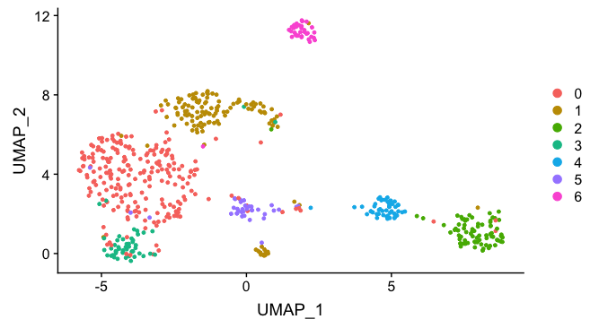
Seven cell clusters identified vs four clusters according to the publication

Slide 5
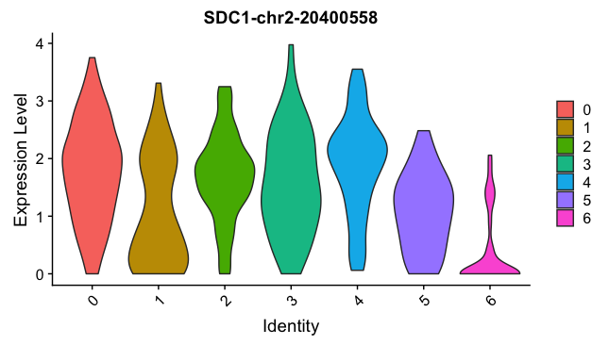
CD138 positive cell types
Cluster 6 has the lowest CD138 expression level.
Is this immune cell cluster (TILs)?

Slide 6
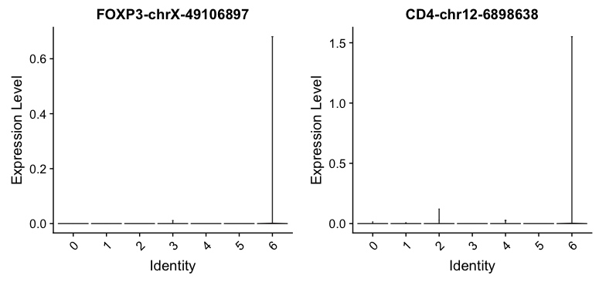
Very small amount of Treg
cells may be present at cluster 6

Slide 7
Differential expression gene analysis for cluster 6 vs other clusters
Gene | p_val | avg_logFC | pct.1 | pct.2 | p_val_adj | cluster
MIR650-chr22-23165270 | 5.75E-59 | 0.438229034 | 0.618 | 0.012 | 1.35E-54 | 6
ADAM23-chr2-207308368 | 1.88E-53 | 0.312150888 | 0.412 | 0 | 4.39E-49 | 6
DDX60-chr4-169137442 | 3.67E-51 | 0.723577056 | 0.706 | 0.034 | 8.58E-47 | 6
HPGD-chr4-175411328 | 3.60E-42 | 0.740459196 | 0.324 | 0 | 8.41E-38 | 6
LY6E-chr8-144099902 | 8.79E-41 | 1.261901297 | 0.941 | 0.123 | 2.06E-36 | 6
KLHL4-chrX-86772715 | 9.82E-41 | 0.471421333 | 0.559 | 0.025 | 2.30E-36 | 6
GPR63-chr6-97241998 | 1.20E-33 | 0.850186669 | 0.529 | 0.032 | 2.81E-29 | 6
ST6GALNAC3-chr1-76540389 | 7.54E-32 | 0.380830147 | 0.294 | 0.004 | 1.76E-27 | 6
RAB31-chr18-9708228 | 7.23E-29 | 1.148367798 | 0.824 | 0.128 | 1.69E-24 | 6
SNX9-chr6-158244294 | 1.57E-27 | 1.031014624 | 0.912 | 0.195 | 3.67E-23 | 6

Slide 8



Acknowledgement

